Slide 1


Project name
HR Analysis – Employee Retention
Guided By-
Dipti Sinha
Group-5
Presented By –
Sneha Chavre
Stephan Samm
Ishani Zoting
shyam singh
Santosh kumbhar
Joshua denis
Anuja Guwalani
Ruchika vaidya

Slide 2
Project Objective
This is HR analysis project Which Shows the details about Employee Retention related to HR Domain.
The main goal of an employee retention project is to reduce turnover by creating a work environment where employees are motivated to stay, grow, and contribute over the long term. This includes identifying and addressing the root causes of employee dissatisfaction, improving overall employee engagement, and ensuring that the organization's policies, culture, and benefits align with the needs and expectations of the workforce.
The data is used in this project includes 2 datasets Excel File with having 50K Record in each File.
We used MS-Excel, MySQL for analyzing, cleaning and removing duplicates from dataset and prepared dashboard using Tableau and Power BI tools where we did calculations, merging and prepared interactive dashboards.

Slide 3

Contents
KPI-1 : Average Attrition rate for all Departments
KPI-2 : Average Hourly rate of Male Research Scientist
KPI-3 : Attrition rate Vs Monthly income stats
KPI-4 : Average working years for each Department
KPI-5 : Job Role Vs Work life balance
KPI-6: Attrition rate Vs Year since last promotion relation

Slide 4
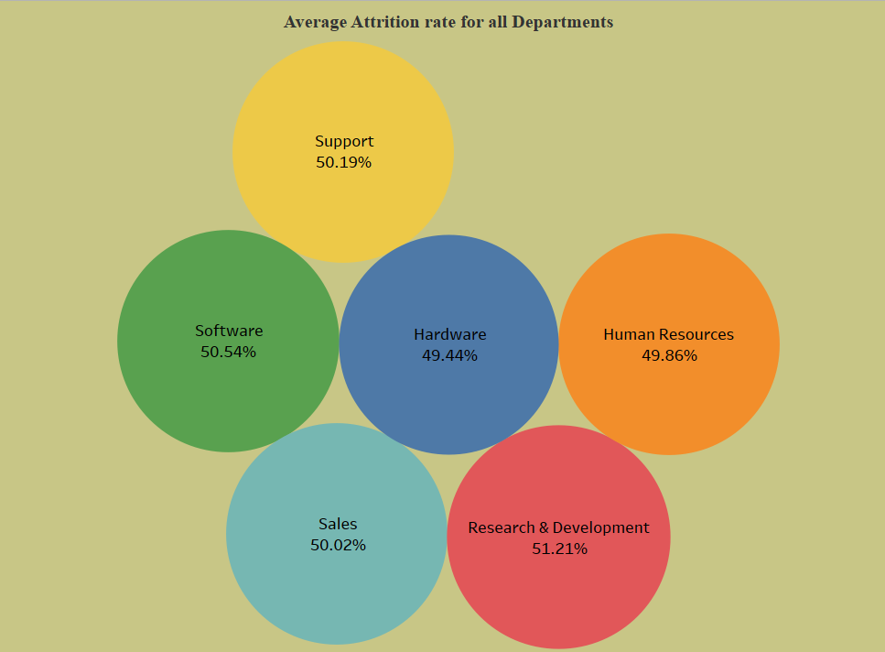
KPI - 1.Average Attrition rate for all Departments
Here We can see Research And Development Department has Highest Attrition Rate i.e.51.21%.
While Hardware has the lowest Attrition Rate
That is 49.44%.

Slide 5
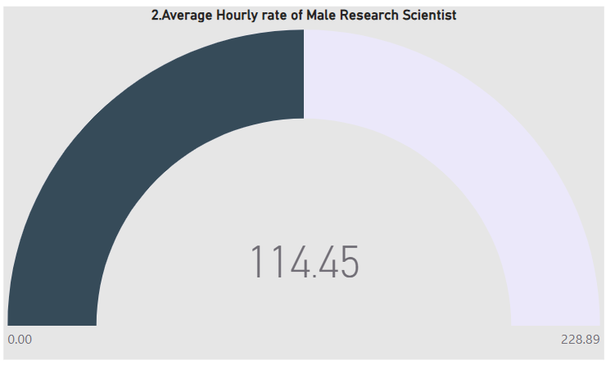
2.Average Hourly rate of Male Research Scientist
Here Average Hourly Rate For Male Research Scientist coming out is 114.45

Slide 6
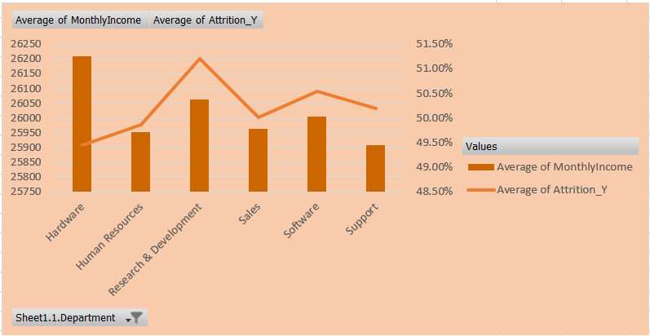
3.Attrition rate Vs Monthly income stats
Here, We Can See in the Chart that maximum Salary hike is for 20K-30K Salary.
And Maximum Attrition Rate is from 40K-50K Salary that may be because they are getting better salary option in other company for the same work.

Slide 7
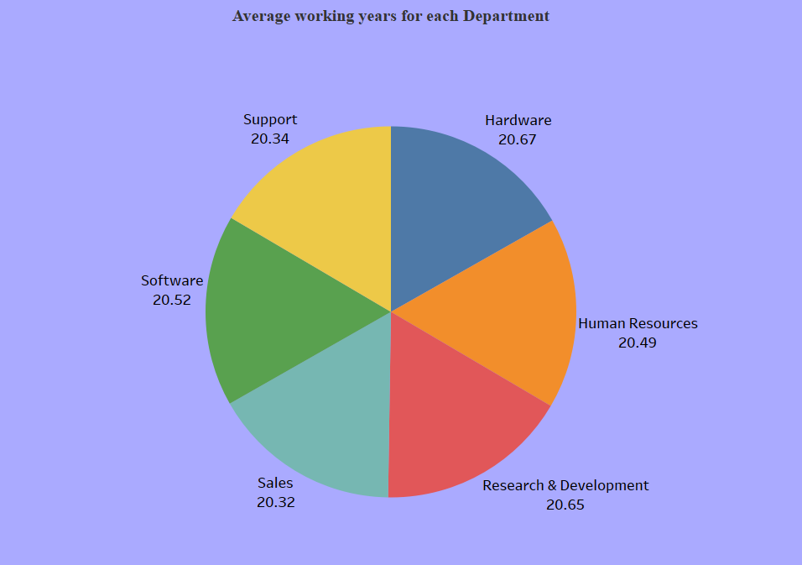
4.Average working years for each Department
Here Average Working Year for hardware is 20.67 And Research & Development Department is 20.65 this is highest.
But in Sales 20.32 And Support Department has 20.34 this indicates we have to work on Sales & Support Department.

Slide 8
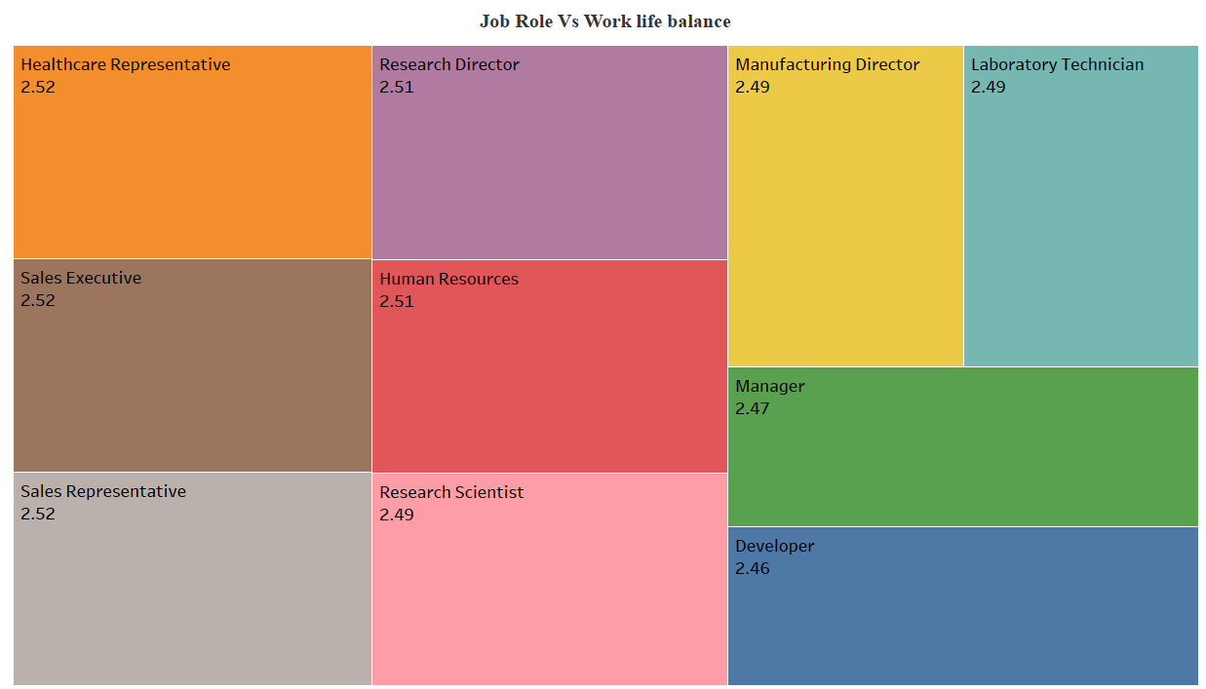
5.Job Role Vs Work life balance
At 2.52, Healthcare Representative had the highest Average of Work Life Balance and was 2.33% higher than Developer, which had the lowest Average of Work Life Balance at 2.46.﻿
﻿Across all 10 Job Role, Average of Work Life Balance ranged from 2.46 to 2.52. ﻿

Slide 9
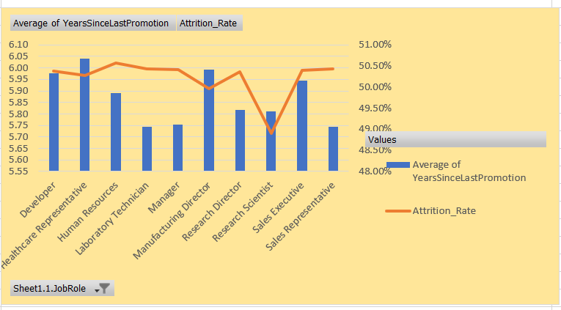
6.Attrition rate Vs Year since last promotion relation
﻿Healthcare Representative had the highest Average of Years Since Last Promotion and was 5.17% higher than Sales Representative, which had the lowest Average of Years Since Last Promotion at 5.74.﻿
﻿Average of Years Since Last Promotion and Average of Attrition Rate diverged the most when the Job Role was Healthcare Representative, when Average of Years Since Last Promotion were 5.54 higher than Average of Attrition Rate.
﻿Across all 10 Job Role, Average of Years Since Last Promotion ranged from 5.74 to 6.04 and Average of Attrition Rate ranged from 49 to 51.

Slide 10
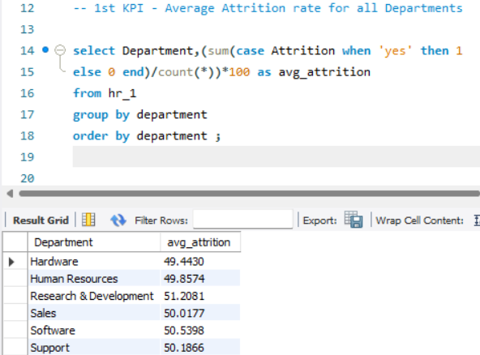
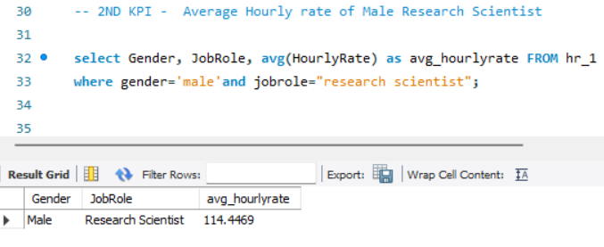
KPI - 1.Average Attrition rate for all Departments
2.Average Hourly rate of Male Research Scientist

Slide 11
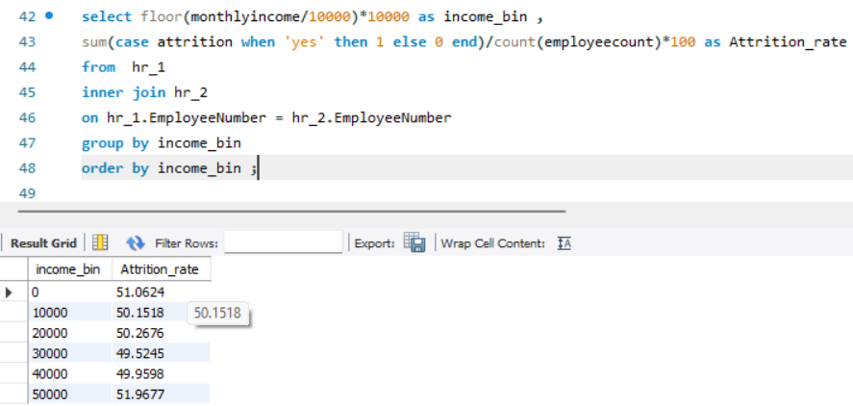
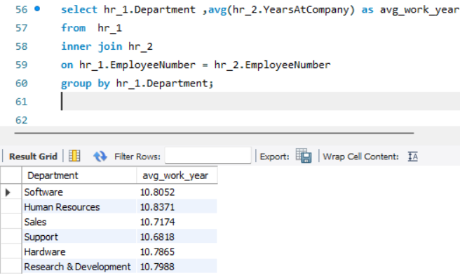
3.Attrition rate Vs Monthly income stats
4.Average working years for each Department

Slide 12
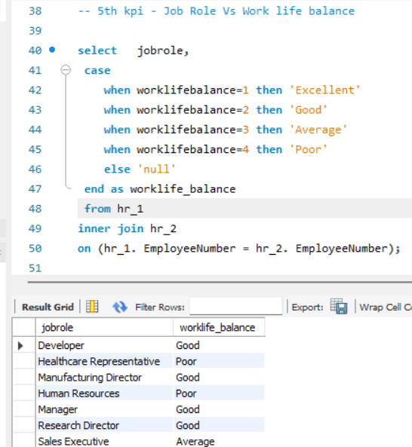
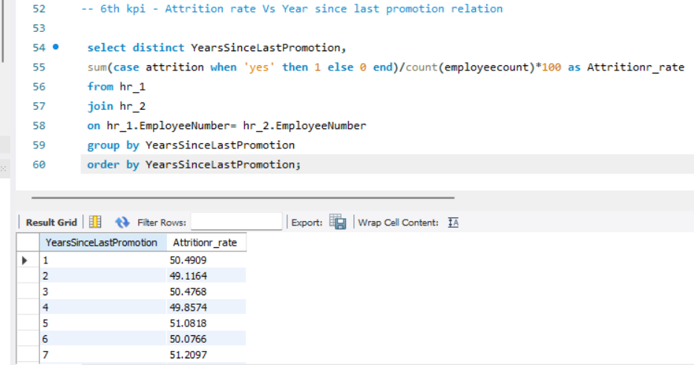
5.Job Role Vs Work life balance
6.Attrition rate Vs Year since last promotion relation

Slide 13
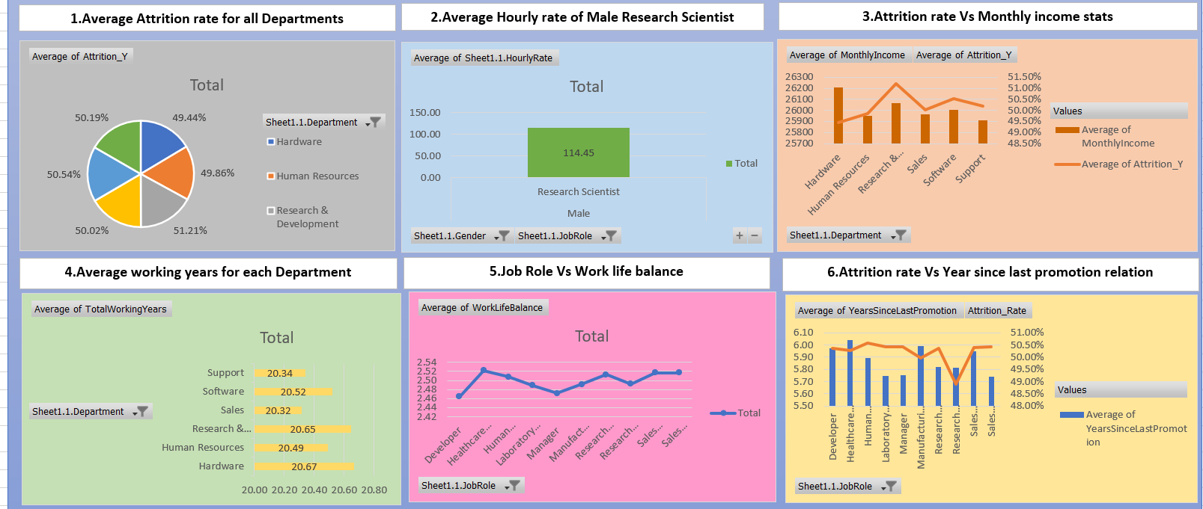
HR Analysis Dashboard in Excel

Slide 14
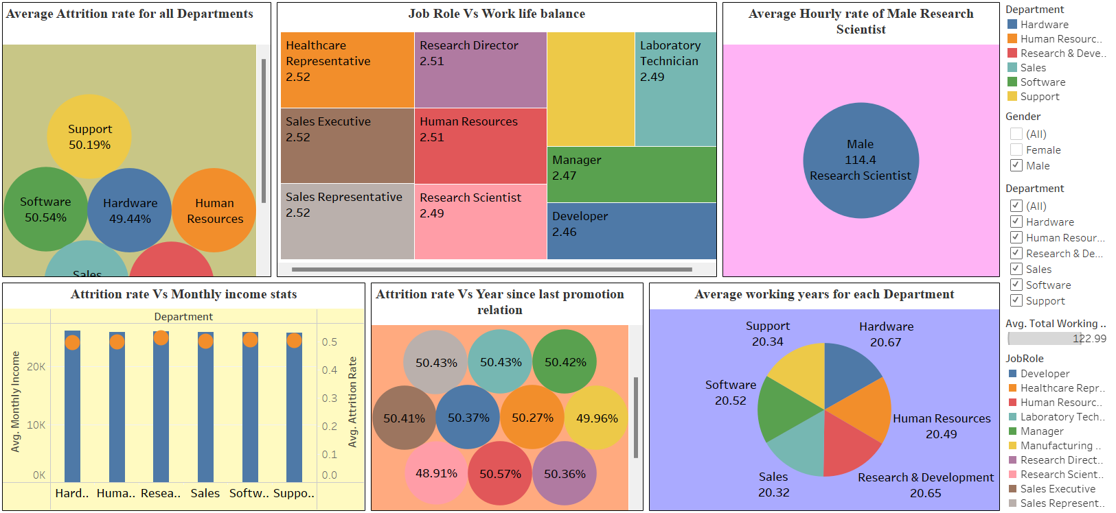
HR Analysis Dashboard in Tableau

Slide 15
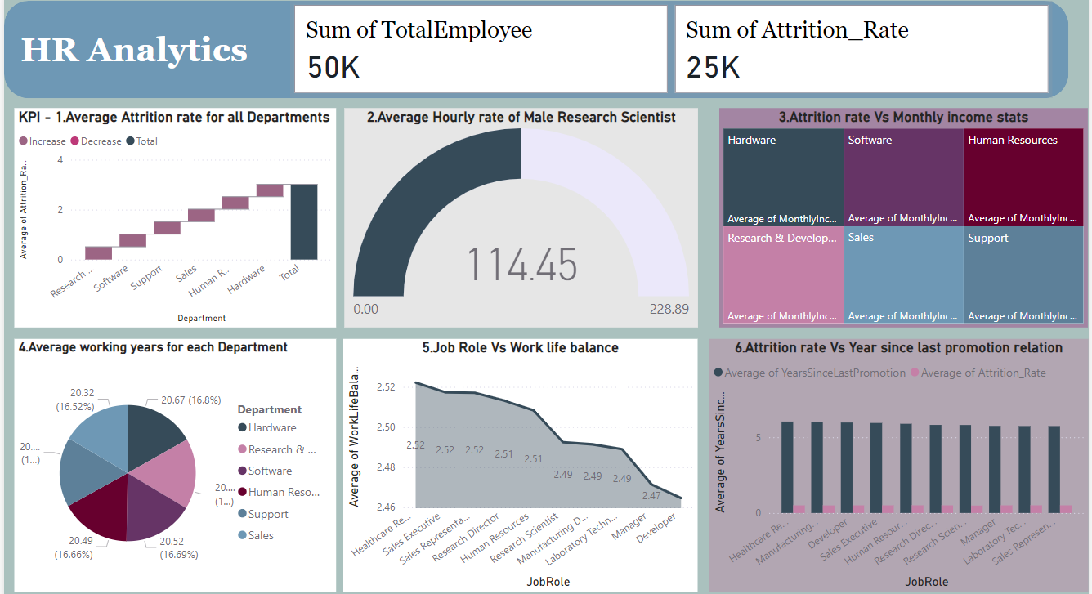
HR Analysis Dashboard in Power Bi

Slide 16
Thank you

